Slide 1

Multi-Dimensional Arrays
Pushpa G, Asst.Prof,
Dept.of CSE,PES University,Bangalore

Slide 2
Introduction to Arrays
An array is a fixed-size sequential collection of elements of same data types that share a common name.
It is simply a group of data types.
An array is a derived data type.
An array is used to represent a list of numbers , or a list of names.

Slide 3
Types of arrays
One-dimensional-A variable which represent the list of items using only one index (subscript) is called one-dimensional array.
Two dimensional-A variable which represent the list of items using two index (subscript) is called two-dimensional array.
Three dimensional or multi-dimensional -A variable which represent the list of items using more than two index (subscript) is called multi-dimensional array.
The general form of multi dimensional array is : type array-name[s1][s2][s3]…….[sn];

Slide 4
INITIALIZATION OF TWO-DIMENSIONAL ARRAYS :
Example : int table[ ][3] = {{0,0,0}, {1,1,1}};
If the values are missing in an initializer, they are automatically set to zero.
Example : int table[2][3] = {1,1,2};
Here first row initialize to 1,1 and 2, and second row initialize to 0,0 and 0 automatically.

Slide 5
Memory Layout of Two-dimensional array
In Two dimensional arrays, the data is stored in rows and columns format.
For example: int table[2][3] = {1,2,3,4,5,6};
The memory layout of above example : table[0][0] = 1; table[0][1] = 2 table[0][2] = 3; table[1][0] = 4; table[1][1] = 5;

Slide 6
Different ways to initialize two-dimensional array
Initialization of a 2d array:
Ex1:int c[2][3] = {{1, 3, 0}, {-1, 5, 9}};
Ex2:int c[][3] = {{1, 3, 0}, {-1, 5, 9}};
Ex3:int c[2][3] = {1, 3, 0, -1, 5, 9};

Slide 7
Syntax of multi-dimensional Arrays
Syntax:- datatype array name[size][size][size];
Ex:- int a[3][3][3];

Slide 8
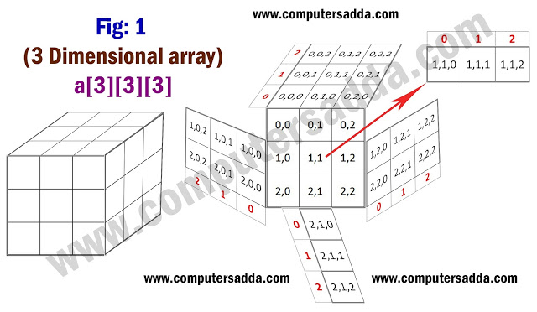
View of Multi as cube

Slide 9
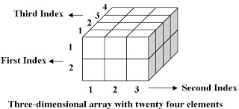
View2

Slide 10
Initialization and accessing of multi
int x[2][3][4] = {0, 1, 2, 3, 4, 5, 6, 7, 8, 9, 10, 11, 12, 13, 14, 15, 16, 17, 18, 19, 20, 21, 22, 23};
int x[2][3][4] = { { {0,1,2,3}, {4,5,6,7}, {8,9,10,11} }, { {12,13,14,15}, {16,17,18,19}, {20,21,22,23} } };
Ex:for (i=0;i<2;i++)
{ for(j=0;j<3;j++)
{for(k=0;k<4;k++)
printf(“%d”,x[i][j][k]);
}
}

